Slide 1
ALGORITHM
SIDDHARTHA BANERJEE
RAMAKRISHNA MISSION RESIDENTIAL COLLEGE (AUTONOMOUS), NARENDRAPUR

Slide 2
PRAM ALGORITHM
1. INTRODUCTION
So far our discussion of algorithms has been confined to single-processor computers.
In this chapter we study algorithms for parallel machines(i.e., computers with more than one processor).
There are many applications in day-to-day life that demand real-time solutions to problems.
For example, weather forecasting has to be done in a timely fashion. In the case of severe hurricanes or snowstorms, evacuation has to be done in a short period of time.

Slide 3
PRAM ALGORITHM
1. INTRODUCTION
If an expert system is used to aid a physician in surgical procedures, decisions have to be made within second.
Programs written for such applications have to perform an enormous amount of computation.
In the forecasting example, large-sized matrices have to be operated on. In the medical example, thousands of rules have to be tried.
Even the fastest single-processor machines may not be able to come up with solutions within tolerable time limits.

Slide 4
PRAM ALGORITHM
1. INTRODUCTION
Parallel machines offer the potential of decreasing the solution times enormously.

Slide 5
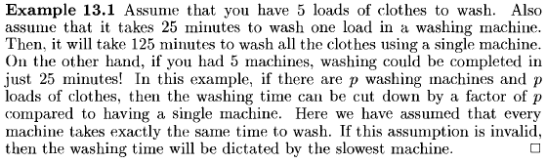
PRAM ALGORITHM
1. INTRODUCTION

Slide 6

PRAM ALGORITHM
1. INTRODUCTION

Slide 7
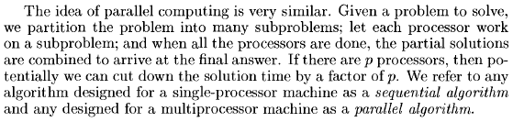
PRAM ALGORITHM
1. INTRODUCTION

Slide 8

PRAM ALGORITHM
1. INTRODUCTION

Slide 9

PRAM ALGORITHM
1. INTRODUCTION

Slide 10
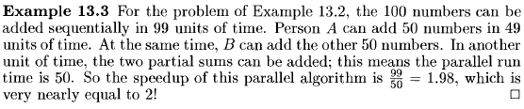
PRAM ALGORITHM
1. INTRODUCTION

Slide 11

PRAM ALGORITHM
1. INTRODUCTION

Slide 12

PRAM ALGORITHM
1. INTRODUCTION

Slide 13

PRAM ALGORITHM
1. INTRODUCTION

Slide 14
PRAM ALGORITHM
1. INTRODUCTION

Slide 15
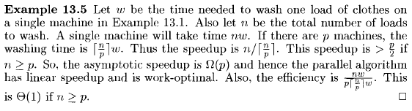
PRAM ALGORITHM
1. INTRODUCTION

Slide 16
PRAM ALGORITHM
1. INTRODUCTION

Slide 17
PRAM ALGORITHM
1. INTRODUCTION

Slide 18
PRAM ALGORITHM
1. INTRODUCTION

Slide 19
PRAM ALGORITHM
1. INTRODUCTION

Slide 20
PRAM ALGORITHM
1. INTRODUCTION

Slide 21
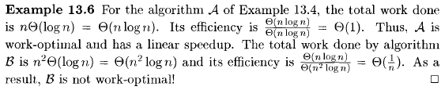
PRAM ALGORITHM
1. INTRODUCTION

Slide 22
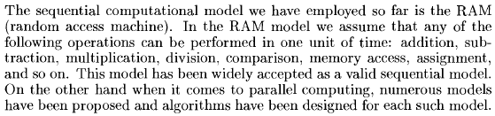
PRAM ALGORITHM
2. COMPUTATIONAL MODEL

Slide 23


PRAM ALGORITHM
2. COMPUTATIONAL MODEL

Slide 24
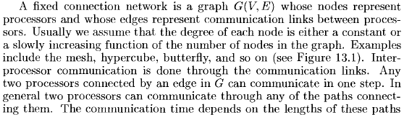
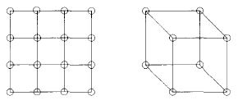
PRAM ALGORITHM
2. COMPUTATIONAL MODEL

Slide 25

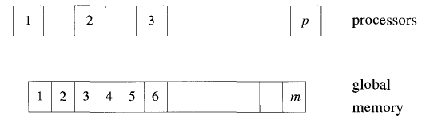
PRAM ALGORITHM
2. COMPUTATIONAL MODEL

Slide 26
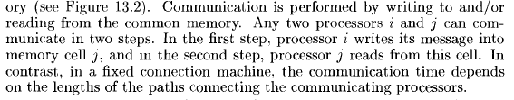
PRAM ALGORITHM
2. COMPUTATIONAL MODEL

Slide 27

PRAM ALGORITHM
2. COMPUTATIONAL MODEL

Slide 28
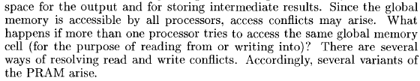
PRAM ALGORITHM
2. COMPUTATIONAL MODEL

Slide 29
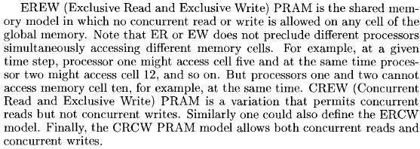
PRAM ALGORITHM
2. COMPUTATIONAL MODEL

Slide 30

PRAM ALGORITHM
2. COMPUTATIONAL MODEL

Slide 31
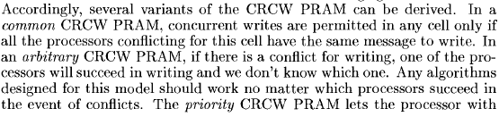
PRAM ALGORITHM
2. COMPUTATIONAL MODEL

Slide 32
PRAM ALGORITHM
2. COMPUTATIONAL MODEL

Slide 33
PRAM ALGORITHM
2. COMPUTATIONAL MODEL

Slide 34
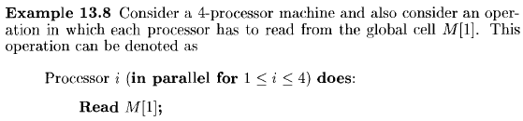
PRAM ALGORITHM
2. COMPUTATIONAL MODEL

Slide 35
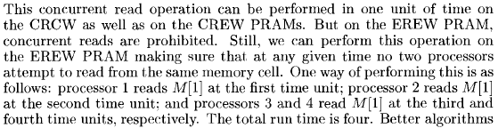
PRAM ALGORITHM
2. COMPUTATIONAL MODEL

Slide 36
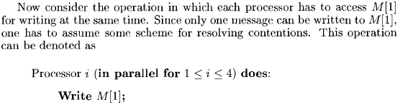
PRAM ALGORITHM
2. COMPUTATIONAL MODEL

Slide 37
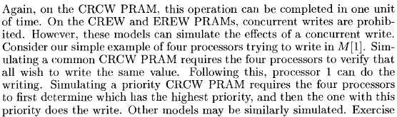
PRAM ALGORITHM
2. COMPUTATIONAL MODEL

Slide 38

PRAM ALGORITHM
2. COMPUTATIONAL MODEL

Slide 39

PRAM ALGORITHM
2. COMPUTATIONAL MODEL

Slide 40
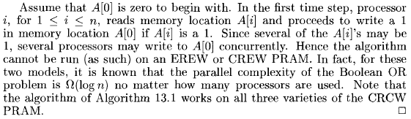
PRAM ALGORITHM
2. COMPUTATIONAL MODEL

Slide 41
PRAM ALGORITHM
2. COMPUTATIONAL MODEL

Slide 42

PRAM ALGORITHM
3. SELECTION

Slide 43

PRAM ALGORITHM
3. SELECTION
3.1 Maximal Selection with n² Processors

Slide 44
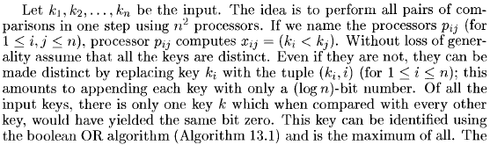
PRAM ALGORITHM
3. SELECTION
3.1 Maximal Selection with n² Processors

Slide 45
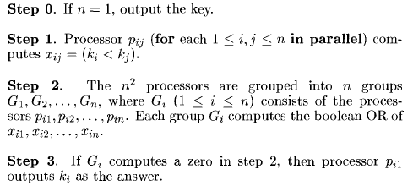
PRAM ALGORITHM
3. SELECTION
3.1 Maximal Selection with n² Processors

Slide 46

PRAM ALGORITHM
3. SELECTION
3.1 Maximal Selection with n² Processors

Slide 47

PRAM ALGORITHM
3. SELECTION
3.1 Maximal Selection with n² Processors

Slide 48
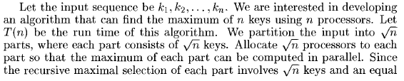

PRAM ALGORITHM
3. SELECTION
3.1 Maximal Selection with n Processors

Slide 49
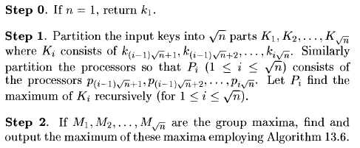
PRAM ALGORITHM
3. SELECTION
3.1 Maximal Selection with n Processors

Slide 50
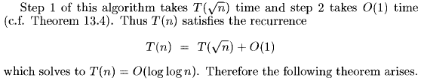
PRAM ALGORITHM
3. SELECTION
3.1 Maximal Selection with n Processors

Slide 51
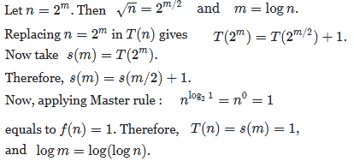
PRAM ALGORITHM
3. SELECTION
3.1 Maximal Selection with n Processors

Slide 52

PRAM ALGORITHM
3. SELECTION
3.1 Maximal Selection with n Processors

Slide 53
PRAM ALGORITHM
Merging,
Sorting,
Graph Algorithms,
Computing the Convex Hull
:
:

Slide 54
Thank you

